Slide 1
ISSUE 2:
Non-linear SVM algorithm
Suppose we are given the following positively labeled data points:
(3;-2) (4;2) (-1;3) (-3;-2)
and the following negatively labeled data points:
(0;1) (0;-1) (-1;-1) (-1;1).
Let's plot these points on the coordinate plane.
Notes:
8080: The world’s first general- purpose microprocessor. This was an 8-bit
machine, with an 8-bit data path to memory. The 8080 was used in the first
personal computer, the Altair.
8086: A far more powerful, 16-bit machine. In addition to a wider data path and larger registers, the 8086 sported an instruction cache, or queue, that prefetches a few instructions before they are executed.
80486: The 80486 introduced the use of much more sophisticated and powerful cache technology and sophisticated instruction pipelining. The 80486 also offered a built-in math coprocessor, offloading complex math operations from the main CPU.
Pentium: With the Pentium, Intel introduced the use of superscalar techniques, which allow multiple instructions to execute in parallel.
Pentium Pro: The Pentium Pro continued the move into superscalar organization begun with the Pentium, with aggressive use of register renaming, branch
prediction, data flow analysis, and speculative execution.
Pentium II: The Pentium II incorporated Intel MMX technology, which is designed specifically to process video, audio, and graphics data efficiently.

Slide 2
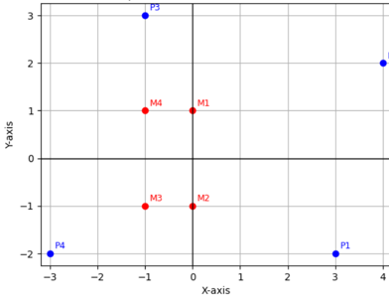
Non-linear SVM algorithm
With this arrangement, it is impossible to draw a plane separating the data. It is necessary to transform the space into another one in which points can be divided into two classes.
These classes turned out to be linearly inseparable.
Let's introduce the space distortion formula.
Notes:
Moore observed that the number of transistors that could be
put on a single chip was doubling every year, and correctly predicted that this pace
would continue into the near future.
3. The computer becomes smaller, making it more convenient to place in a variety of environments.
4. There is a reduction in power requirements.
5. The interconnections on the integrated circuit are much more reliable than
solder connections. With more circuitry on each chip, there are fewer interchip connections.

Slide 3
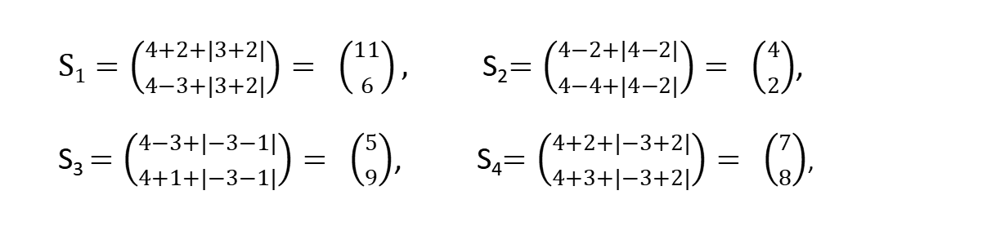
Non-linear SVM algorithm
Our goal, again, is to discover a separating hyperplane that accurately discriminates two classes.
Of course, it is obvious that no such hyperplane exist in the input space.
Therefore, we must use a nonlinear SVM (that is we need to convert data from one feature space to another.)
If $\sqrt{{х_{1}}^{2}+{х_{2}}^{2} }$ > 2, then $S=\left({x_{1} \atop x_{2}}\right)=\left({4−x_{2}+\left|x_{1}−x_{2}\right| \atop 4−x_{1}+\left|x_{1}−x_{2}\right|}\right)$, otherwise $\left({x_{1} \atop x_{2}}\right)$
$\text{S}\text{1}=\left({4+2+|3+2| \atop 4−3+|3+2|}\right)= \left({11 \atop 6}\right),$ S₂$=\left({4−2+|4−2| \atop 4−4+|4−2|}\right)= \left({4 \atop 2}\right)$,
S₃ $=\left({4−3+|−3−1| \atop 4+1+|−3−1|}\right)= \left({5 \atop 9}\right)$, S₄$=\left({4+2+|−3+2| \atop 4+3+|−3+2|}\right)= \left({7 \atop 8}\right)$,
Notes:
A microcontroller chip makes a substantially different use of the logic space available. Microcontrollers are heavily utilized in automation processes.
Another typical feature of a microcontroller is that it does not provide for human interaction. The microcontroller is programmed for a specific task, embedded in its device, and executes as and when required.
A microcontroller is a single chip that contains the processor,
non-volatile memory for the program (ROM), volatile memory for input and output
(RAM), a clock, and an I/O control unit
The processor portion of the microcontroller has a much lower silicon area than other microprocessors and much higher energy efficiency.

Slide 4
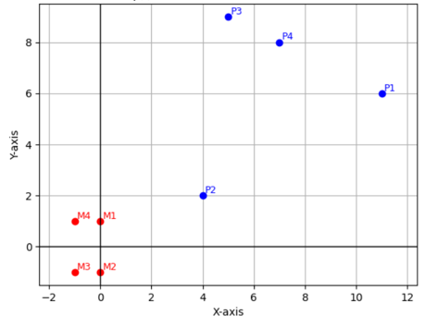
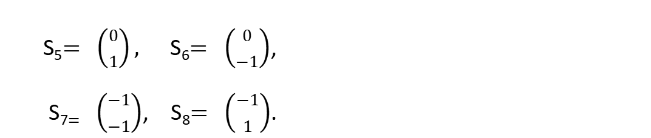
Non-linear SVM algorithm
S₅$= \left({0 \atop 1}\right),$S₆$= \left({0 \atop −1}\right)$,
S₇$= \left({−1 \atop −1}\right)$, S₈$= \left({−1 \atop 1}\right)$.
For negatively labeled points, the condition is not met, so we will leave the negatively labeled points unchanged. The hyperplane can be transformed in some vector space.
Let's find a mapping of the object space to a vector space with a transformed topology.
Notes:
A microcontroller chip makes a substantially different use of the logic space available. Microcontrollers are heavily utilized in automation processes.
Another typical feature of a microcontroller is that it does not provide for human interaction. The microcontroller is programmed for a specific task, embedded in its device, and executes as and when required.
A microcontroller is a single chip that contains the processor,
non-volatile memory for the program (ROM), volatile memory for input and output
(RAM), a clock, and an I/O control unit
The processor portion of the microcontroller has a much lower silicon area than other microprocessors and much higher energy efficiency.

Slide 5
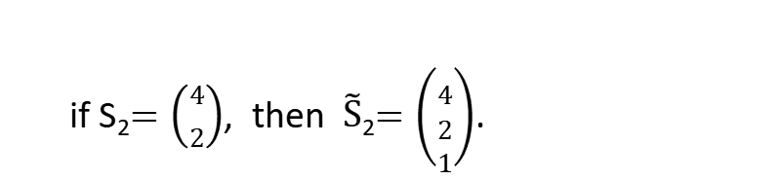
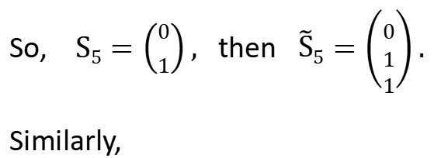
Non-linear SVM algorithm
Now we can easily identify the support vectors: $\left\{\text{S}\text{2}=\left({4 \atop 2}\right)\text{, }\text{S}\text{5}=\left({0 \atop 1}\right)\right\}$.
Each vector is augmented with a 1 as a bias input:
So, $\text{S}\text{5}=\left({0 \atop 1}\right),$ then $\tilde{\text{S}}\text{5}=\left({0 \atop \begin{aligned}1 \\ 1\end{aligned}}\right).$
Similarly,
if S₂$=\left({4 \atop 2}\right)$, then $\tilde{\text{S}}$₂$=\left({4 \atop \begin{aligned}2 \\ 1\end{aligned}}\right)$.
Notes:
A microcontroller chip makes a substantially different use of the logic space available. Microcontrollers are heavily utilized in automation processes.
Another typical feature of a microcontroller is that it does not provide for human interaction. The microcontroller is programmed for a specific task, embedded in its device, and executes as and when required.
A microcontroller is a single chip that contains the processor,
non-volatile memory for the program (ROM), volatile memory for input and output
(RAM), a clock, and an I/O control unit
The processor portion of the microcontroller has a much lower silicon area than other microprocessors and much higher energy efficiency.

Slide 6
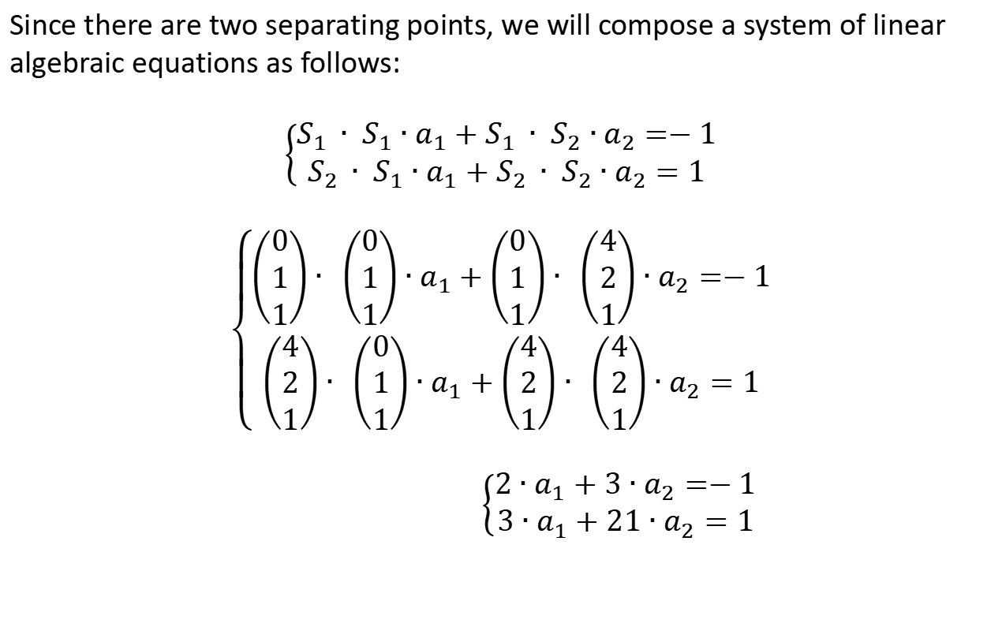
Non-linear SVM algorithm
Since there are two separating points, we will compose a system of linear algebraic equations as follows:
$$\left\{\begin{aligned}S_{1 }∙ S_{1}∙a_{1}+S_{1 }∙ S_{2}∙a_{2}=−1 \\ S_{2 }∙ S_{1}∙a_{1}+S_{2 }∙ S_{2}∙a_{2}=1\end{aligned}\right.$$
$$\left\{\begin{aligned}\left(\begin{matrix}0 \\ 1 \\ 1\end{matrix}\right)∙ \left(\begin{matrix}0 \\ 1 \\ 1\end{matrix}\right)∙a_{1}+\left(\begin{matrix}0 \\ 1 \\ 1\end{matrix}\right)∙ \left(\begin{matrix}4 \\ 2 \\ 1\end{matrix}\right)∙a_{2}=−1 \\ \left(\begin{matrix}4 \\ 2 \\ 1\end{matrix}\right)∙ \left(\begin{matrix}0 \\ 1 \\ 1\end{matrix}\right)∙a_{1}+\left(\begin{matrix}4 \\ 2 \\ 1\end{matrix}\right)∙ \left(\begin{matrix}4 \\ 2 \\ 1\end{matrix}\right)∙a_{2}=1\end{aligned}\right.$$
$\left\{\begin{aligned}2∙a_{1}+3∙a_{2}=−1 \\ 3∙a_{1}+21∙a_{2}=1\end{aligned}\right.$
For the left half-plane it is -1, for the right it is 1.
Notes:
A microcontroller chip makes a substantially different use of the logic space available. Microcontrollers are heavily utilized in automation processes.
Another typical feature of a microcontroller is that it does not provide for human interaction. The microcontroller is programmed for a specific task, embedded in its device, and executes as and when required.
A microcontroller is a single chip that contains the processor,
non-volatile memory for the program (ROM), volatile memory for input and output
(RAM), a clock, and an I/O control unit
The processor portion of the microcontroller has a much lower silicon area than other microprocessors and much higher energy efficiency.

Slide 7
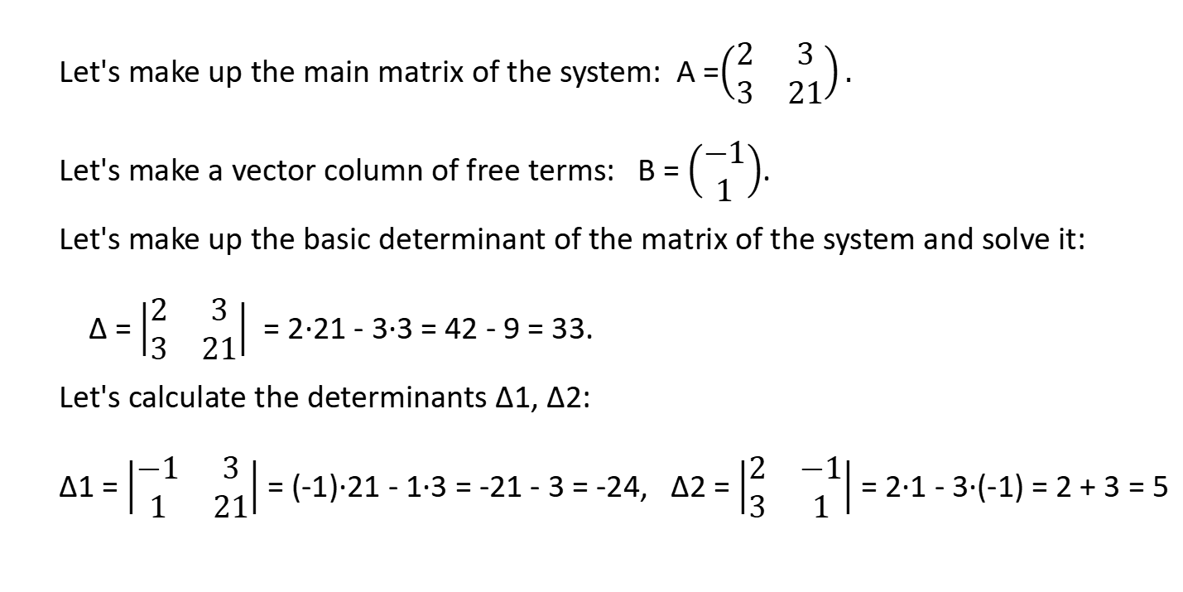
Non-linear SVM algorithm
Let's make up the main matrix of the system: А =$\left(\begin{matrix}2 & 3 \\ 3 & 21\end{matrix}\right).$
Let's make a vector column of free terms: В = $\left(\begin{matrix}−1 \\ 1\end{matrix}\right)$.
Let's make up the basic determinant of the matrix of the system and solve it:
Δ = $\left|\begin{matrix}2 & 3 \\ 3 & 21\end{matrix}\right|$ = 2·21 - 3·3 = 42 - 9 = 33.
Let's calculate the determinants Δ1, Δ2:
Δ1 = $\left|\begin{matrix}−1 & 3 \\ 1 & 21\end{matrix}\right|$ = (-1)·21 - 1·3 = -21 - 3 = -24, Δ2 = $\left|\begin{matrix}2 & −1 \\ 3 & 1\end{matrix}\right|$ = 2·1 - 3·(-1) = 2 + 3 = 5
Notes:
A microcontroller chip makes a substantially different use of the logic space available. Microcontrollers are heavily utilized in automation processes.
Another typical feature of a microcontroller is that it does not provide for human interaction. The microcontroller is programmed for a specific task, embedded in its device, and executes as and when required.
A microcontroller is a single chip that contains the processor,
non-volatile memory for the program (ROM), volatile memory for input and output
(RAM), a clock, and an I/O control unit
The processor portion of the microcontroller has a much lower silicon area than other microprocessors and much higher energy efficiency.

Slide 8
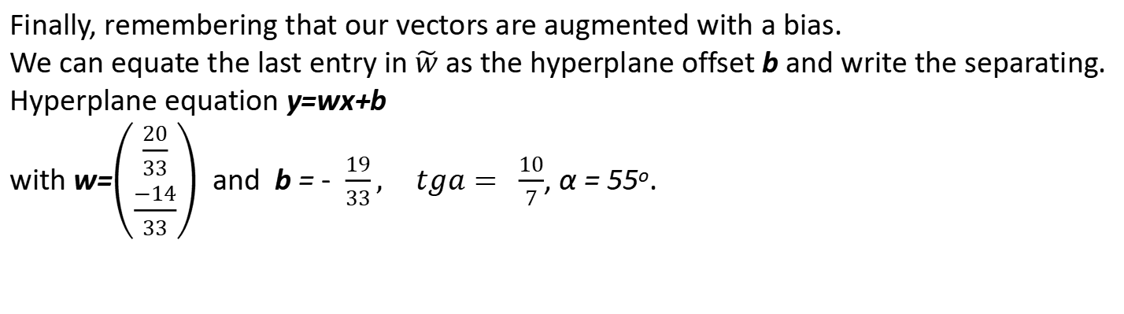
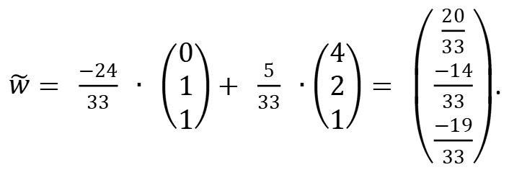
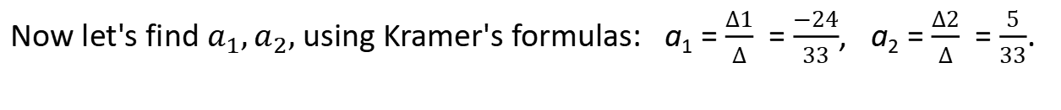
Non-linear SVM algorithm
Now let's find $a_{1},a_{2},$ using Kramer's formulas: a₁ = $\frac{Δ1}{Δ}$ = $\frac{−24}{33}$, a₂ = $\frac{Δ2}{Δ}$ = $\frac{5}{33}$.
$\tilde{w}= \frac{−24}{33} ∙ \left(\begin{matrix}0 \\ 1 \\ 1\end{matrix}\right)+ \frac{5}{33} ∙\left(\begin{matrix}4 \\ 2 \\ 1\end{matrix}\right)= \left(\begin{matrix}\frac{20}{33} \\ \frac{−14}{33} \\ \frac{−19}{33}\end{matrix}\right)$.
Finally, remembering that our vectors are augmented with a bias.
We can equate the last entry in $\tilde{w}$ as the hyperplane offset b and write the separating.
Hyperplane equation y=wx+b
with w=$\left(\begin{aligned}\frac{20}{33} \\ \frac{−14}{33}\end{aligned}\right)$ and b = - $\frac{19}{33},$ $tga= \frac{10}{7}$, α = 55º.
Notes:
A microcontroller chip makes a substantially different use of the logic space available. Microcontrollers are heavily utilized in automation processes.
Another typical feature of a microcontroller is that it does not provide for human interaction. The microcontroller is programmed for a specific task, embedded in its device, and executes as and when required.
A microcontroller is a single chip that contains the processor,
non-volatile memory for the program (ROM), volatile memory for input and output
(RAM), a clock, and an I/O control unit
The processor portion of the microcontroller has a much lower silicon area than other microprocessors and much higher energy efficiency.

Slide 9
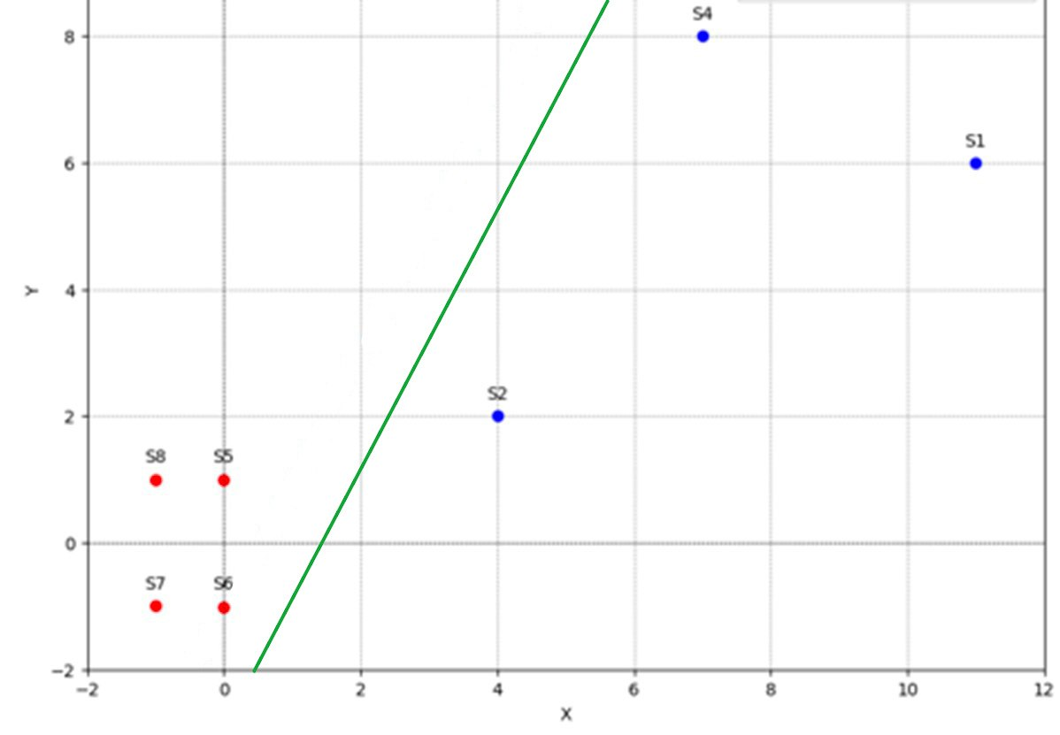
Let's build a hyperplane that will divide the points into classes
Notes:
A microcontroller chip makes a substantially different use of the logic space available. Microcontrollers are heavily utilized in automation processes.
Another typical feature of a microcontroller is that it does not provide for human interaction. The microcontroller is programmed for a specific task, embedded in its device, and executes as and when required.
A microcontroller is a single chip that contains the processor,
non-volatile memory for the program (ROM), volatile memory for input and output
(RAM), a clock, and an I/O control unit
The processor portion of the microcontroller has a much lower silicon area than other microprocessors and much higher energy efficiency.

